Slide 1
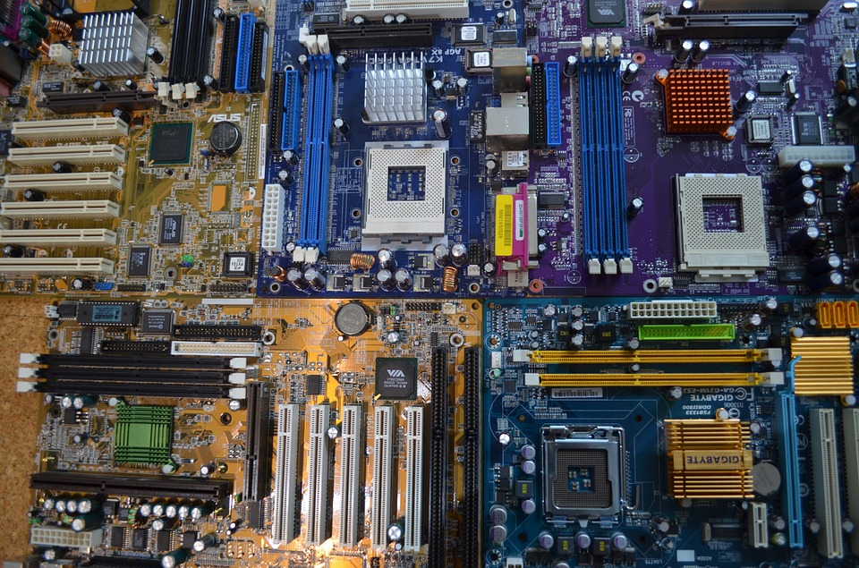
What's inside a PC?!
Module A.2
By Yoshita Yadav

Slide 2
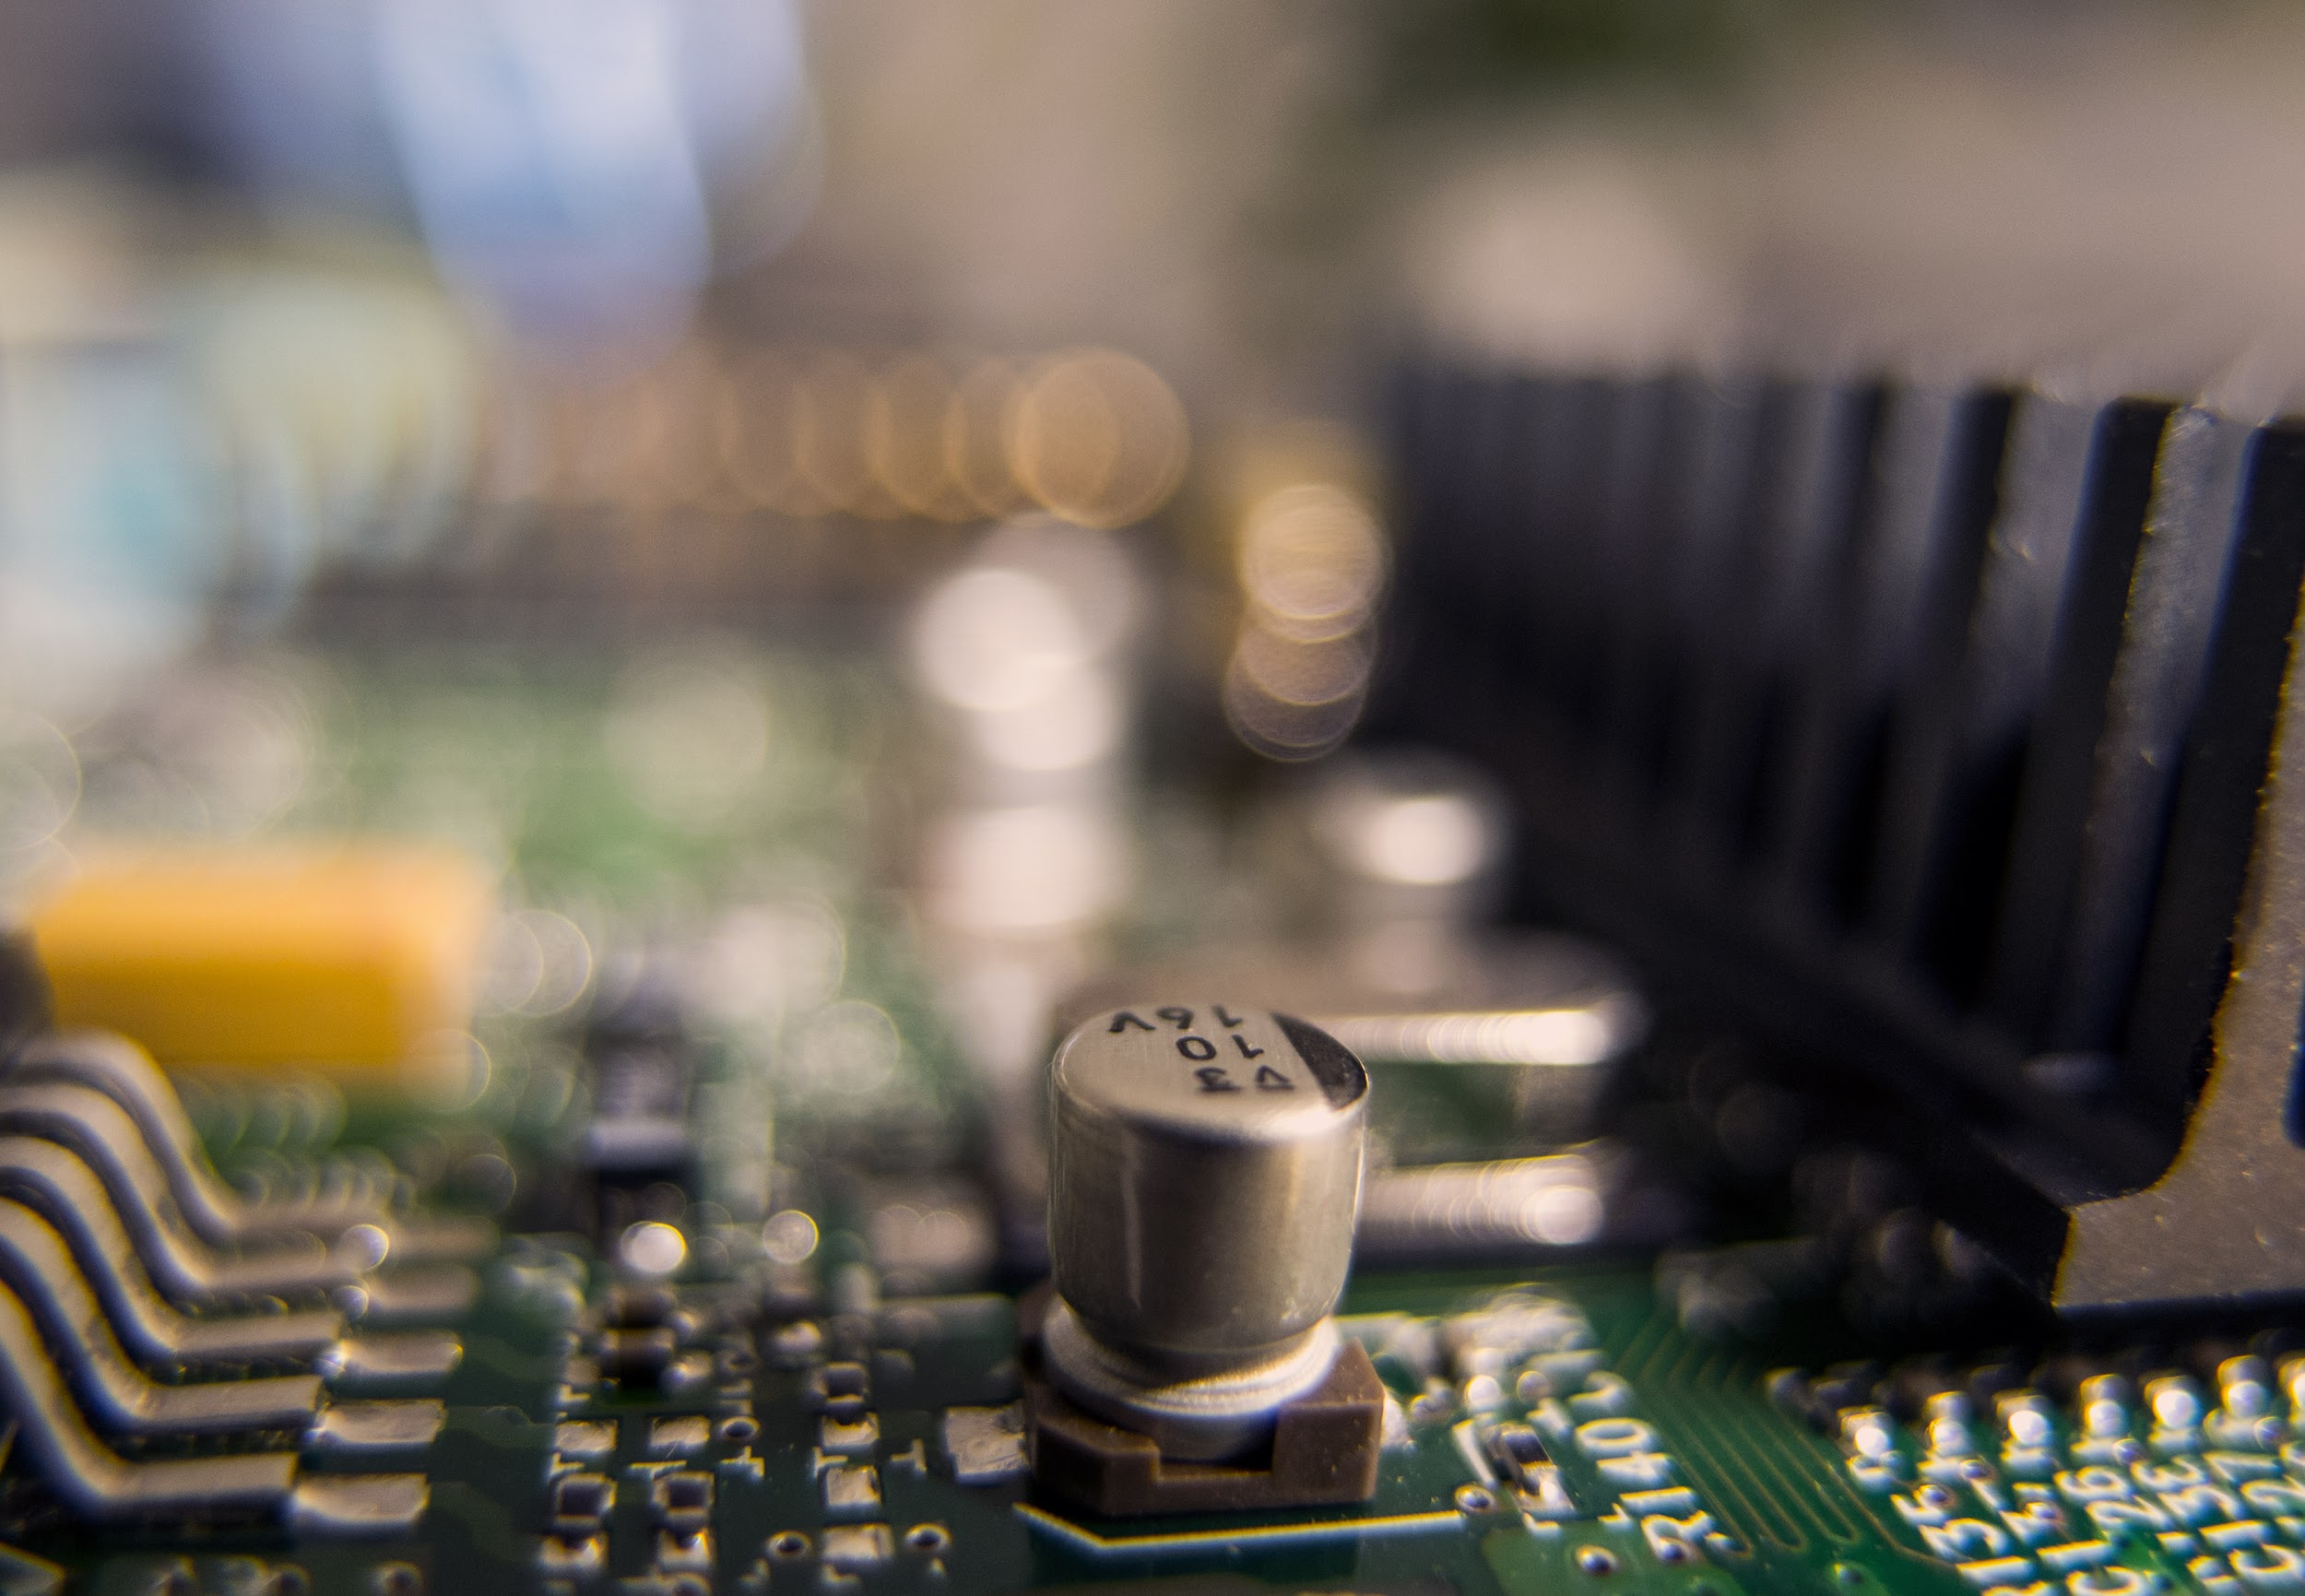
Level 1- PC Tower Case

Slide 3
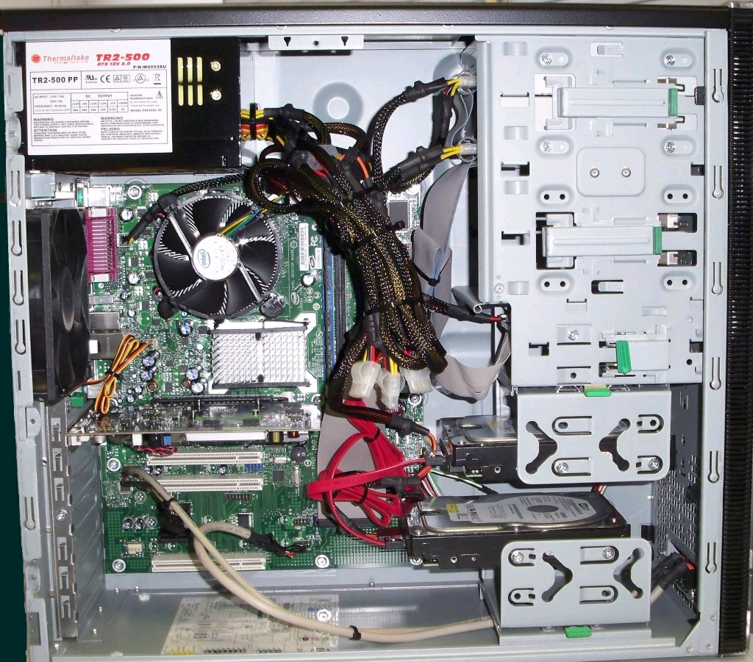
Power Supply
Optical Disk Drive
Cooling Fan
RAM
Video Card
Hard DIsk Drive
Motherboard

Slide 4
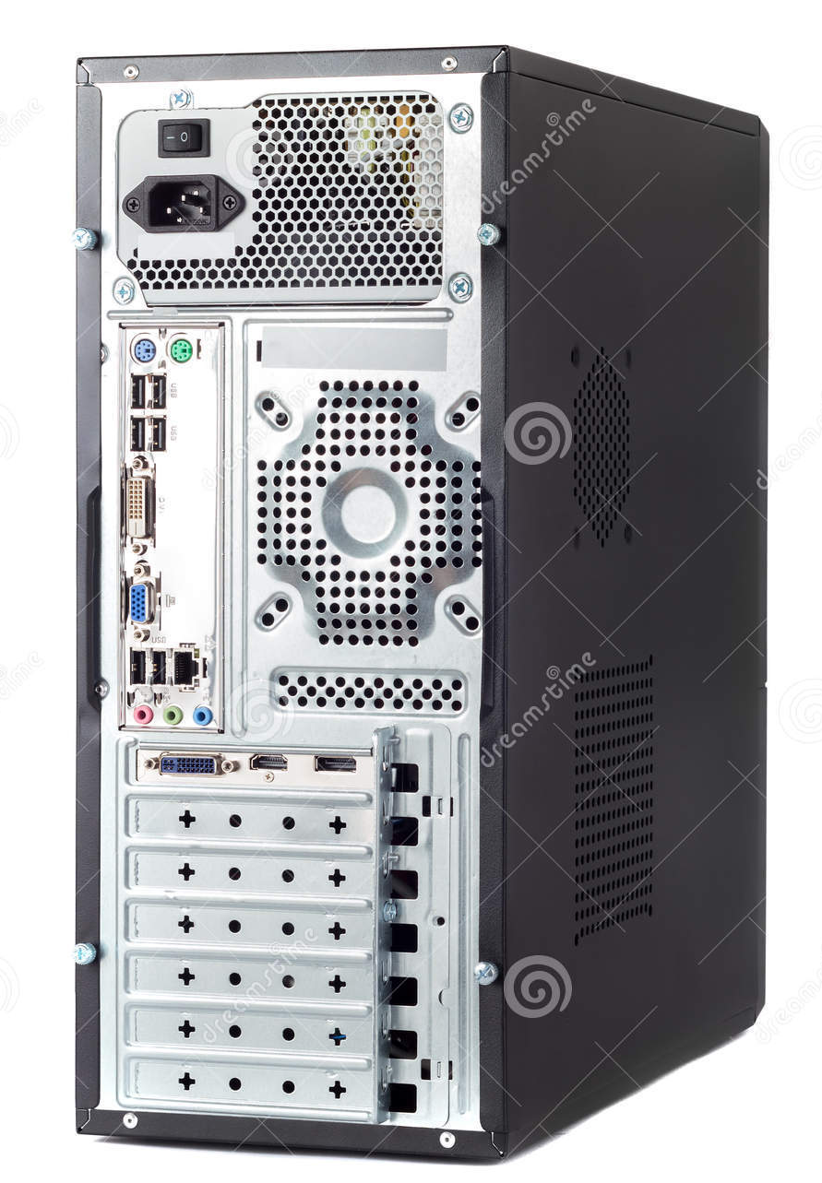
Contd Of Previous Slide
Power In
DVI (Monitor Port )
VGI (Monitor Port)
USB Expansion Port
Ethernet Port
Audio Ports (Mic, Speakers)

Slide 5
1. Research more in-depth about “Motherboards”. Make notes on the following:
a. What different versions are currently available (speed and capacity)
The speed of a motherboard depends on the Bus speed. Bus speed usually refers to the speed of the front side bus (FSB), which connects the CPU to the northbridge. FSB speeds can range from 66 MHz to over 800 MHz nowadays.
b. How the component has changed since the 1980’s
In the 1980s components like graphics, networking, SCSI and sound were not built on the motherboard and remained separated .
Whereas in motherboards now, we have those components (graphic cards, sound card etc) built on the motherboard.

Slide 6
2. Research more in-depth about “Hard Disk Drives”. Make notes on the following:
What different versions are currently available (speed and capacity)
Computer hard drives can offer sizes of up to 500 gigabytes (GB) to 1 Terabytes
How the component has changed since the 1980’s
In the 1980s, hard drive for personal computers were rare and highly expensive whereas nowadays every computer has a hard drive.
The hard drives in 1980s offered a size of upto 10 MB whereas now the sizes of hard drives can be upto 1 TB.

Slide 7
Level 2- PC Motherboard

Slide 8
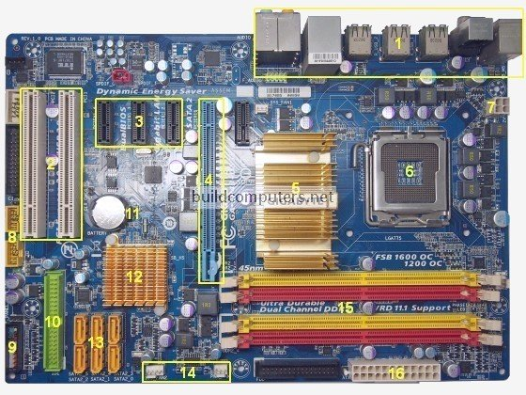
Back Panel Ports & Connectors (see next slide for more details)
Expansion Cards such as SOUND CARD, Ethernet card etc
Processor(CPU)
With fan underneath it .
Video Card
IDE Connector
RAM
SATA

Slide 9
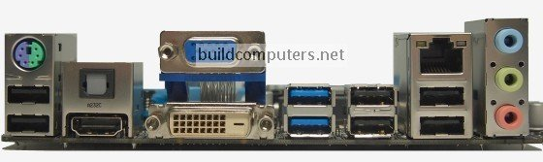
Contd Of Previous Slide
Ethernet Port

Slide 10
1. Research more in-depth about “CPU Processor Chip”. Make notes on the following:
What different versions are currently available (speed and capacity)
The size of a fast Processor can range from 2.6 GHZ to 3.2 GHZ
How the component has changed since the 1980’s
The size of older processor chips ranged from 16- 32 bits whereas now it ranges from 2.6 to 3.2 GHZ

Slide 11
1. Research more in-depth about “RAM Memory ”. Make notes on the following:
What different versions are currently available (speed and capacity)
RAM speed is measured in Megahertz (MHz), millions of cycles per second, so that it can be compared to your processor's clock speed
For desktops and laptops, memory speed can range from the standard 1333MHz all the way up to speeds of 2133MHz.
How the component has changed since the 1980’s
In the 1980s, the size of RAM was measured in kilobyte or megabyte whereas now its measured in MHz

Slide 12
Level 3-Peripheral Devices

Slide 13
Purple PS/2 port: Keyboard Port
Power In
DVI (Monitor Port )
Green PS/2 port: Mouse Port
VGI (Monitor Port)
USB Expansion Port
Ethernet Port
Audio Ports (Mic, Speakers)

Slide 14
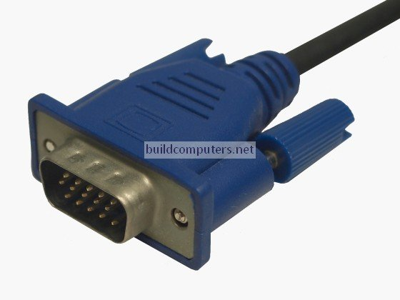
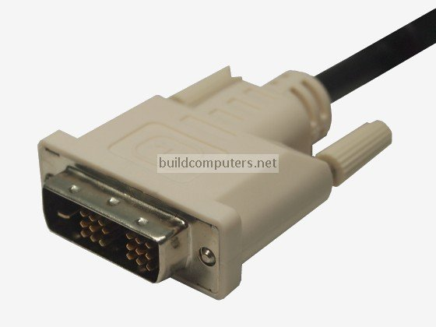
Peripheral Devices Ports
VGA Port - Monitor Interface
DVI Port- Monitor Interface

Slide 15
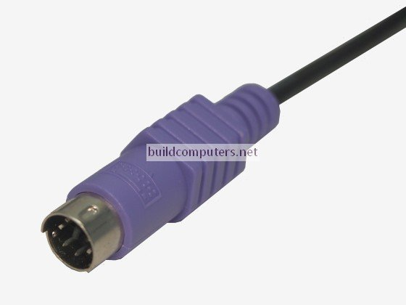
Peripheral Devices Ports
PS/2 Port- Mouse and Keyboard Interface

Slide 16
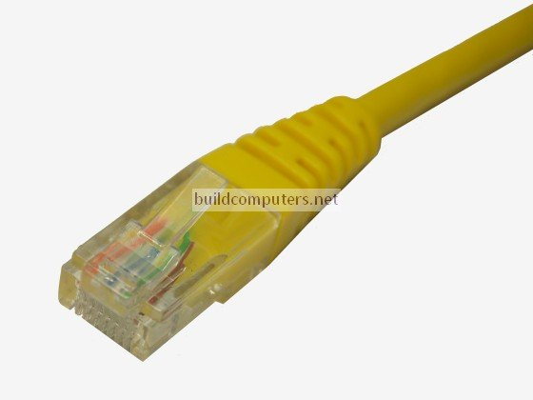
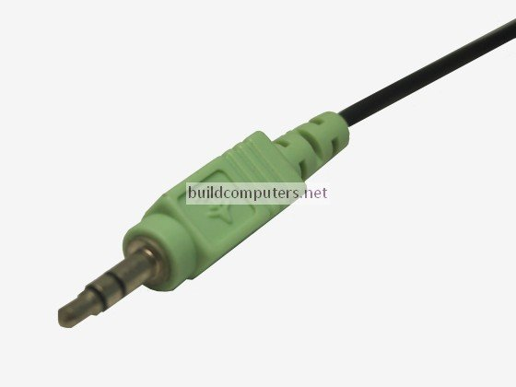
Peripheral Devices Ports
Ethernet Cable- ethernet Interface
Audio Port- Audio

Slide 17
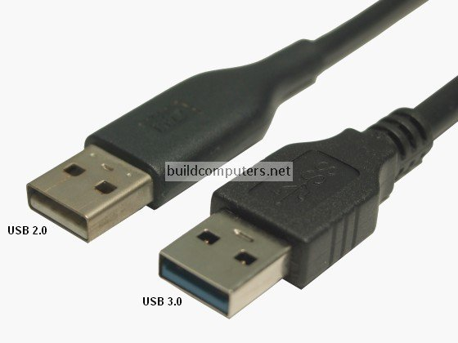
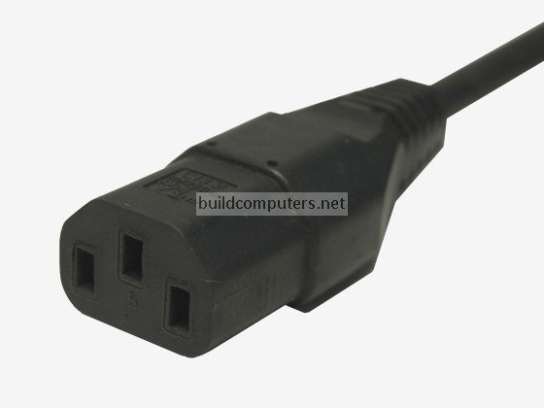
Peripheral Devices Ports
USB Cable
Power Cords

Slide 18
1. Research more in-depth about “Monitor Technology”. Make notes on the following:
a. What different versions are currently available
Most desktop displays use liquid crystal display (LCD) or cathode ray tube (CRT) technology, while nearly all portable computing devices such as laptops incorporate LCD technology. Because of their slimmer design and lower energy consumption, monitors using LCD technology (also called flat panel or flat screen displays) are replacing the venerable CRT on most desktops.

Slide 19
b. How the component has changed since the 1980’s (e.g. Display Resolution, Technology)
The memory capacity of a video card now, ranges from 1 GB to 12 GB
Back then a video card would be a few MB.
The frame rate then was less than 60 FPS but now is way more than that.

